Slide 1

Ministry of Education
and Science of Georgia
Challenges and Initiatives
for 2010-2011
2010

Slide 2
Challenges for 2010-2011
Increasing the Importance of the High School Diploma
Encouraging Students to Attend Classes
Improving and Finalizing the National Curriculum
Improving the Quality of Textbooks
Introducing and Developing the Concept of Safe Schools
Increasing Teachers’ Proficiency Level Through Certification
Actively Involving Local Self-Governance Bodies in the Education Process
Improving Infrastructure
Enhancing Communication Between the Ministry, Education Resource Centers and Schools
Enhancing Learning of the Georgian Language for Non-Georgian Population
Increasing an Access to Education for Children with Special Educational Needs

Slide 3
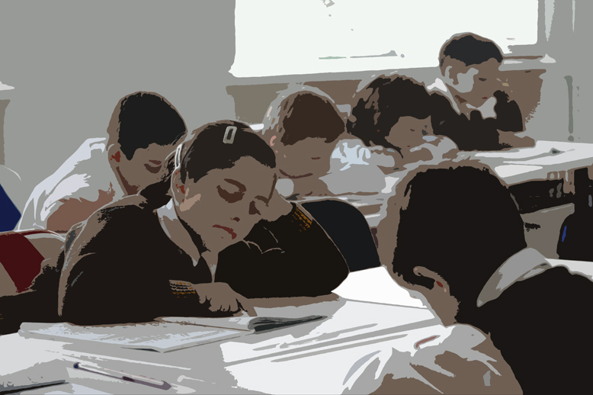
Increasing the Importance of the
High School Diploma
Overcoming the Minimum Competency Barrier in the National Examination Centers in order to Receive a High School Diploma (from 2010)
Providing Students with Intensive Preparation Courses in the 12th Grade to Overcome the Minimum Competency Barrier (2010-2011)

Slide 4
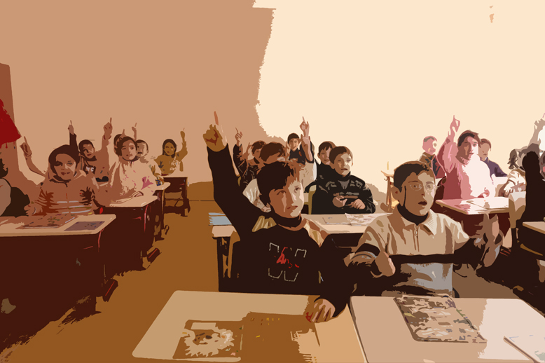
Encouraging Students to Attend Classes
Attendance as One of the Main Components of the Student’s Evaluation Criteria
Improving and Finalizing the National Curriculum
Raising Students’ Motivation to Study through Interactive Lessons
Encouraging More Local and International Olympics and Contests
Providing Access for Exchange Programs to Students
Enlarging Summer-School Programs
Supporting High School Honor Graduate Program (Medal Program)

Slide 5

Improving and Finalizing the
National Curriculum
Improving and Finalizing the National Curriculum for all 12 Grades
Leaving the New National Curriculum Unchanged for 5 Subsequent Years
Integrating New Subjects into the National Curriculum:
- Civil Defense and Safety
- Information Technology
- World Culture
Replacing Physical Culture by Sports Classes

Slide 6

Improving the Quality of Textbooks
Bringing School Textbooks in Full Compliance with the National Curriculum
Ensuring Transparency of the Approval Process of Textbooks
Making Textbook Approval Rules Stricter
Adopting Common Technical Standards for Textbooks (Size, Weight, Shape, Division, Font)
Monitoring Schools for Using Non-Approved Textbooks on a Regular Basis

Slide 7

Introducing and Developing the
Concept of Safe Schools
Introducing the Institution of the Security Guards in Schools
Dividing Schools into 3 Study Levels
Creating Safe Zones in Schools via Video Cameras
Establishing Credit Card Paying System for Students and Connecting it with Web Portal
Organizing Meetings for Students with Representatives of Police, Prosecutor’s Office and Legal Aid Service in order to Raise their Awareness on Human Rights and other Legal Issues

Slide 8
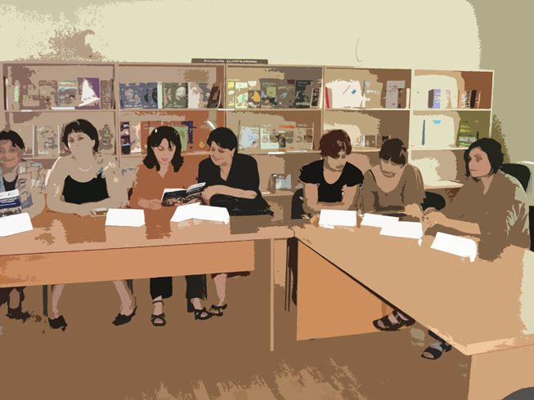
Increasing Teachers’ Proficiency Level through Certification
Teachers’ Voluntary Certification from 2010
Paying Bonuses to Certified Teachers
Providing Permanent Professional Development Training (Teaching Methods, Professional Skills, Information Technologies)
Ensuring Intensive Professional Development Training for Teachers of Foreign Languages
Enhancing the Institution of Mentor-Teachers
Developing and Adopting Teachers Ethics Code
Providing New Additional Professional Textbooks for Teachers

Slide 9
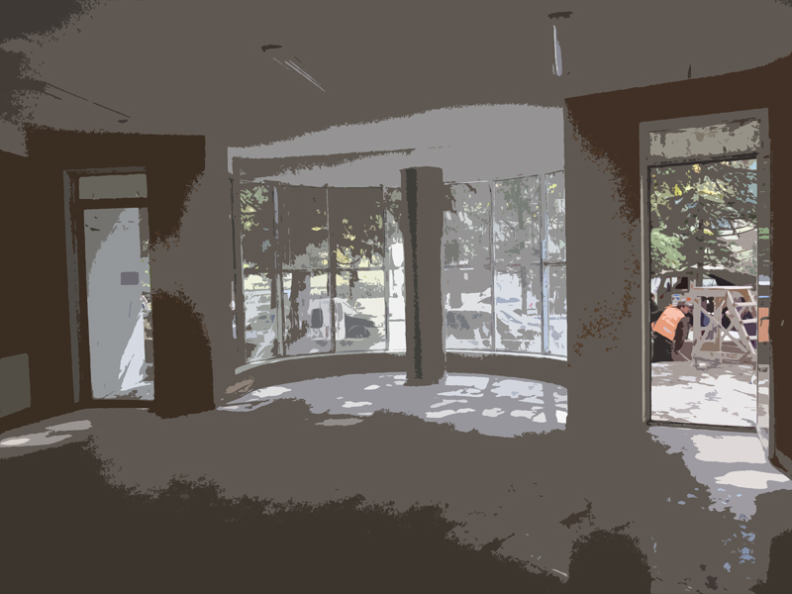
Actively Involving Local Self-Governance Bodies in the Education Process
Allocating 20 million GEL to the Self-Governments for Improving School Infrastructure
Raising Interests of Self-Governments in Organizing Different Activities in Education System
Supporting Self-Governments in Encouraging Teachers and Students

Slide 10
Improving Infrastructure
Optimizing School Communal Expenditures
Improving Logistical Support of Education Resource Centers
Refurbishing School Libraries
Renovating School Cafeterias
Upgrading School Laboratories
Renewing Sports Equipments

Slide 11

Optimizing School Expenditures
Setting up a special computer software that will monitor and examine school communal expenditures. The software will enable the Ministry to provide assistance to schools in financial management.

Slide 12
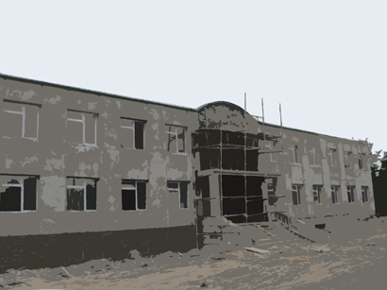
Improving Logistical Support of Educational Resource Centers (ERCs)
  Providing ERCs with the Transportation Means
  Upgrading ERC Infrastructure
  Enhancing Communications between the Ministry, ERCs and Schools

Slide 13

Refurbishing School Libraries
Creating School Library Infrastructure
Providing Libraries with Current Textbooks and other Learning Materials
Developing a Concept of Electronic Libraries

Slide 14
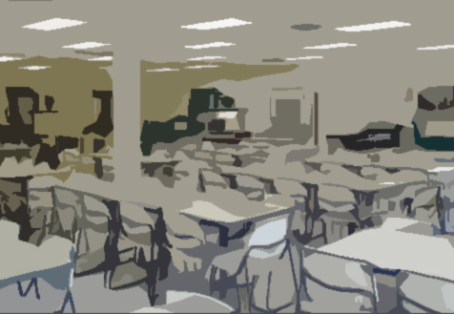
Renovating School Cafeterias
Creating Adequate Infrastructure
Monitoring School Nutrition Standards on a Regular Basis
Outsourcing Food Services from Private Companies
Introducing the Credit Card System

Slide 15
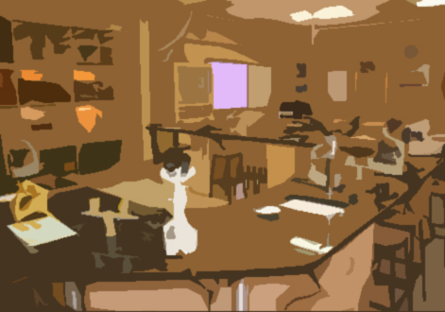
Upgrading School Laboratories
Creating School Laboratories
Providing Lab Equipment to Schools
Using Virtual Labs to Better Master Skills in the Natural Science Subjects

Slide 16
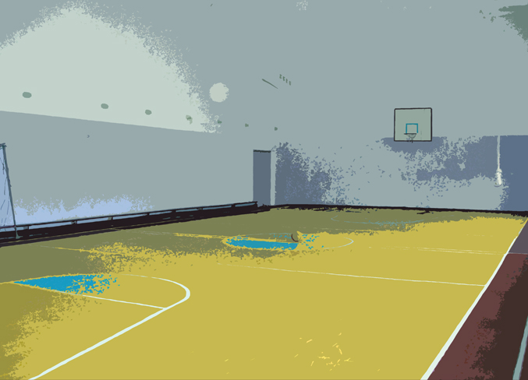
Renewing Sports Equipments
Renovating Sport Indoor and Outdoor Playgrounds with Modern Equipment by Engaging Local Municipalities
Providing Schools with Sports Equipment

Slide 17
Enhancing Communication between the Ministry, ERCs and Schools
Holding Regular Meetings among Teachers, ERCs and Ministry Representatives
Developing a Mechanism of Passing Down the New Decisions in a Timely and Efficient Manner throughout Georgia
Designing an Informative and User-Friendly Web Site of the Ministry
Developing Special Web Portals for Various Target Groups
Providing Live Consultations to Any Interested Person via Special Electronic Monitors
Engaging Teachers in Decision Making Process by Participating in Special Summits (to be Organized in Every Two Weeks in Different Regions of Georgia)

Slide 18
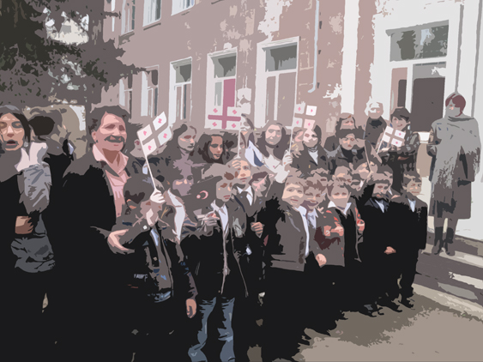
Enhancing the Learning of the Georgian Language for Non-Georgian Population
Expanding the Georgian Language Learning Programs
Encouraging Multilingual Learning
Creating Multilingual School Books with 30% Georgian Texts in order to Make Georgian Learning Process More Engaging and Easy for Students

Slide 19
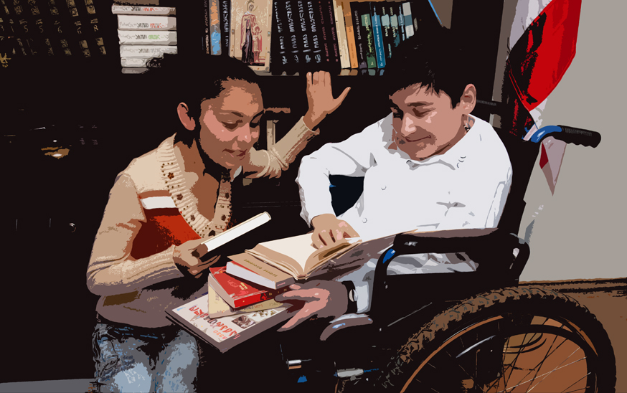
Increasing an Access to Education for the Children with Special Educational Needs
Creating an Electronic Database for Voluntary Registration of the Children with Special Educational Needs
Improving the Intergovernmental Cooperation (Ministry of Labor, Health and Social Affairs, Civil Registry of Ministry of Justice)
Raising Public Awareness on Inclusive Education
Enhancing the Effectiveness of Multidisciplinary Teams’ Activities

Slide 20
Other Initiatives Planned for the Years of 2010-1011

Slide 21
Other Initiatives for the Years of 2010-2011
Introducing the Concept of “Branding of Schools” to Foster the Competitiveness between the Schools
Creating Alumni Clubs
Forming Special Profile Schools
Creating the Students’ Self-Government Boards and Teaching Political Culture at Schools
Implementing a Project “Friends of the Book”

Slide 22
Ministry of
Education and Science of Georgia
2010

